Slide 1
Neural Network Model for the Sales of a Butcher Shop
Tucker Lebor

Slide 2
Pre-Processing
Many of the products were not categorized, ranging from $16,000 to $45 per month
Many products are not easily classified, or in small volume (eg. Lamb), they were ignored
Some unusual patterns may have to be ignored, such as sudden, unrecovered sales drops and whatever happened on 1/13/2016
The original categories had to be checked and combined to form the desired categories (eg. Local Beef=Meat)
Some products changed categories partway through the data

Slide 3
Total Sales
Models for the daily total revenue were run
The best of which was a network of 10 neurons per layer and 7 delays
Moderate overfitting, extrapolation visibly less accurate than interpolating
The pattern of the actual data was not very consistent, so I switched to categorized sales

Slide 4
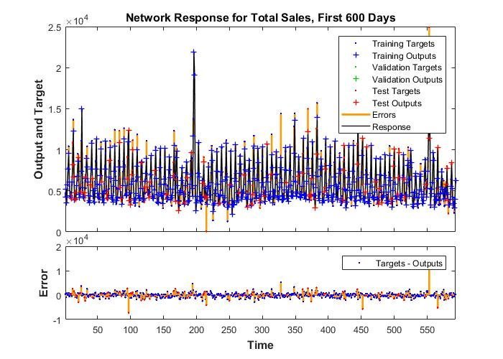
Total Sales
R value of first 600, test points only: 7.492
R value of last 206: 6.314
Bayesian Regularization

Slide 5
Categorized Sales
Started with mid-sized categories: Bakery, Beef, Dairy, Deli, Grocery, Pork, Poultry, Produce, Sausage, Seafood, Alcohol
Massive overfitting, delays reduced to 2
Very little correlation to data when extrapolating
Simpler categories used: Alcohol, Dairy, Deli, Grocery, Meat, Produce

Slide 6
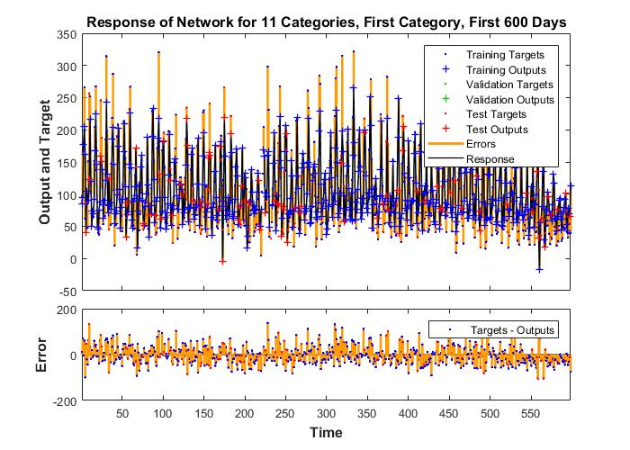
Categorized Sales, 11 Categories
R value of first 600 days (all categories, test points only): 8.91
R value of last 206 days (all categories): 3.61
Bayesian Regularization

Slide 7
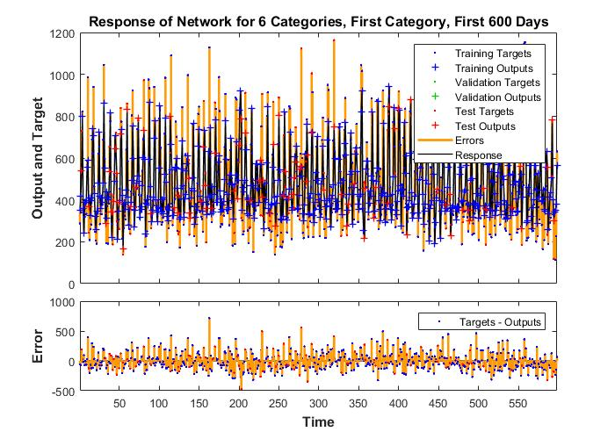
Categorized Sales, 6 Categories
R value of first 600 days (all categories, test points only): 8.85
R value of last 206 days (all categories): 4.46
Bayesian Regularization

Slide 8
Moving sum
function [out] = subsum(dailyData,period)
%This will make each data point the sum of the previous n data points (n is
%the period). this is a moving sum, not a moving average. the timestep does
%not change, the resulting length of the data will be:
%original length - period
%Data must be a matrix with a new timestep in each column
out=sum(dailyData(1:end,1:period)')';
for n=period+1:size(dailyData,2)
out=horzcat(out,sum(dailyData(1:end,n-period+1:n)')');
end
end

Slide 9
Timestep Change
function [out] = stepSum(data,period)
%This function generates consecutive, non-intersecting sums.
%Each sum corresponds to a period of specified length.
%Data must be a matrix with a new timestep in each column.
%Incomplete periods will be truncated from the end.
data=data';
out=sum(data(1:period,1:end));
for n=2:floor(size(data,1)/period
out=vertcat(out,sum(data((n-1)*period+1:n*period,1:end)));
end
out=out';
end

Slide 10
Weekly Moving Sum of Total Sales
Interpolation accuracy of the network is much better, extrapolation has yet to be tested.
Actual data was more consistent, as was the model, though MSE becomes colluded due to massive, infrequent errors

Slide 11
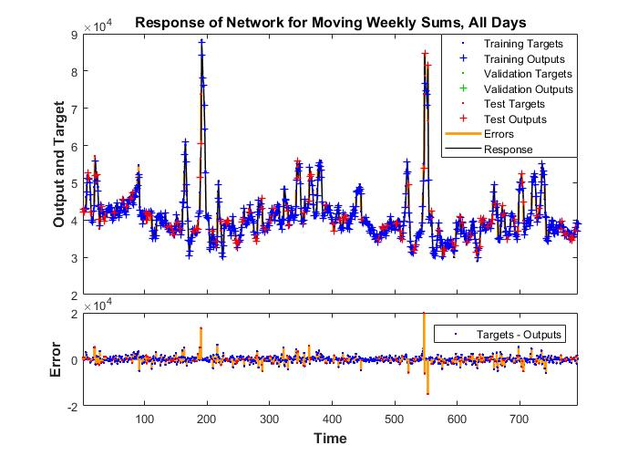
Weekly Moving Sum of Total Sales
R value of test points: 9.21
Bayesian Regularization

Slide 12
To Do
Import data from the last 3 months
Test the extrapolation of the weekly moving sum network
Test networks for weekly data, compare to the accuracy of extrapolating the 7th day of the moving sum data
For daily models, predict the extrapolation by feedback rather than on new data
Compare extrapolations to previously used predictions

Slide 13
Bibliography
Penpece, D., Elma, O. E. (2014). Predicting sales
revenue by using artificial neural network in
grocery retailing industry: a case study in
Turkey. International Journal of Trade,
Economics and Finance, 5, 435-439.
Sano, N., Machino, N., Yada, K., & Suzuki, T. (2015).
Recommendation system for grocery store
considering data sparsity. Procedia Computer
Science, 60, 1406-1413.

Slide 14

Olde Towne Butcher
A butcher shop in Fredericksburg, VA.
Sells various high-end organic goods and produce.
Highly anomalous sales, especially around holidays.

Slide 15
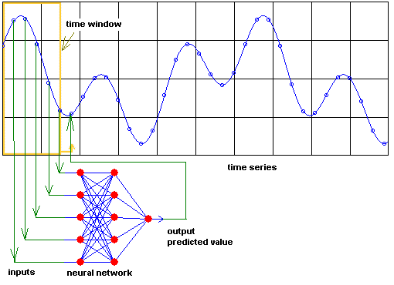
Time series neural network
A neural network is a series of neurons, which communicate to each other by layer and pass values along to a set of output neurons.
Weights alter the information as it passes allowing prioritization and pattern recognition.
Time series problems predict the next data point based on the past n data points.

Slide 16
Time series neural network
Neural networks can be used to recognize faint or unusual patterns that may lead to anomalies in sales.
No user input or identification is needed to develop these patterns.

Slide 17
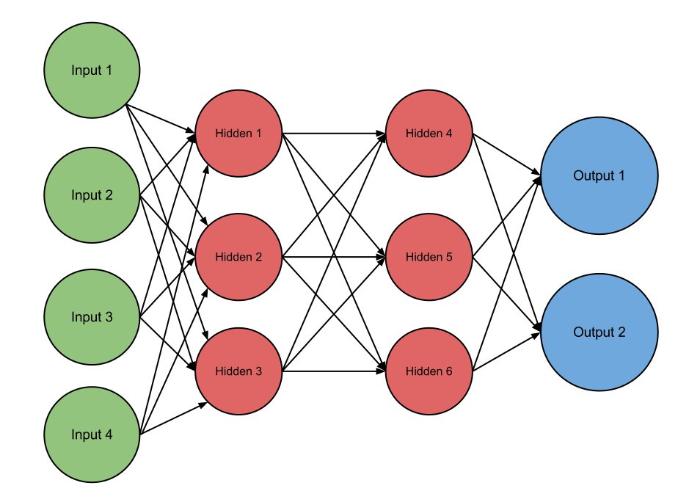
Sales of day t-1 in category 1
Sales of day t-2 in category 1
Sales of day t-1 in category 2
Sales of day t-2 in category 2
Prediction of day t sales in category 1
Prediction of day t sales in category 2

Slide 18
Comparison to previous research
The resulting model will be a combination of a time-series prediction and a correlation / recommendation system.
Studies have been done on both sales prediction (Penpece & Elma, 2014), and product correlation (Sano, Machino, Yada, & Suzuki, 2015).
However, few have done both simultaneously.

